Slide 1

Part I: Install PHP Community
Bringing a New Level of Integrated Simplicity and Open source
into IBM i
Notes:
https://www.youtube.com/watch?v=tIm-gldvZT0
https://www.ibm.com/support/pages/php-ibm-i

Slide 2
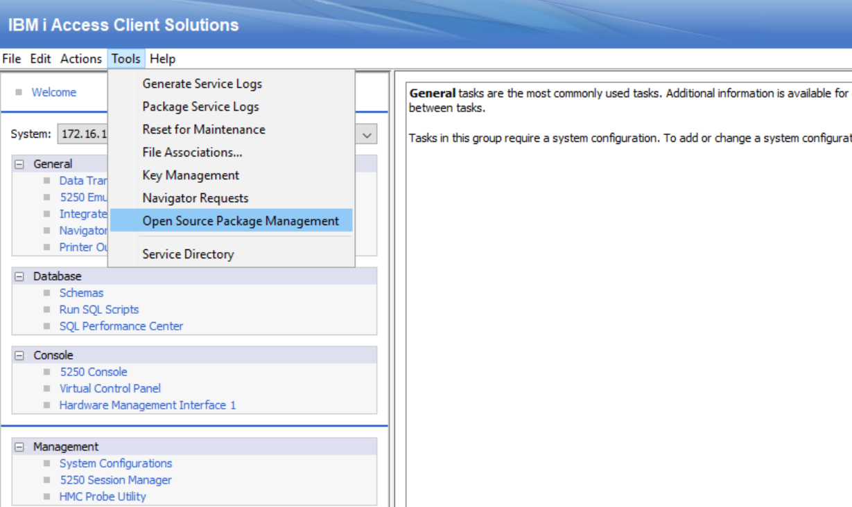
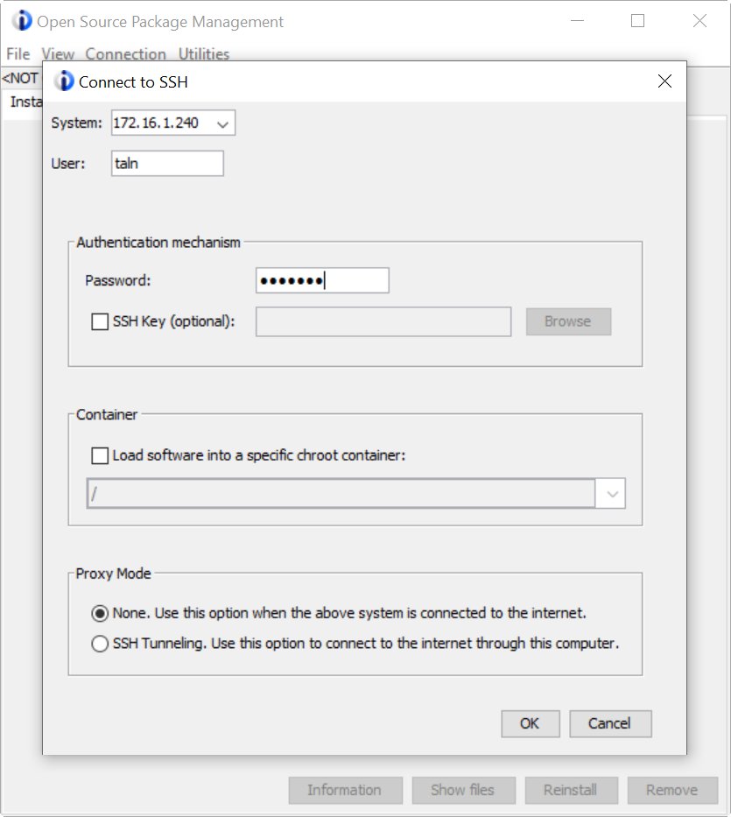
Step 1 : Open the IBM i Access Client Solutions
From the "Tools" menu select the option for "Open Source Package Management"
Notes:
https://ibmi-oss-docs.readthedocs.io/en/latest/nodejs/README.html
https://www.seidengroup.com/php-documentation/how-to-set-up-the-ibm-i-open-source-environment/

Slide 3
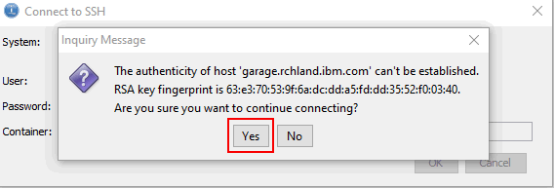
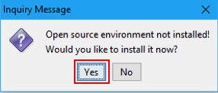
Step 2 : If you receive the following warning, select "Yes" to continue.
Step 3 : Respond with "Yes“ to install YUM
Notes:
https://ibmi-oss-docs.readthed
https://bitbucket.org/ibmi/opensource/src/20192a55b76d99a839815f61100e427ac75cdd11/docs/yum/#markdown-header-offline-install-instructions-without-acsocs.io/en/latest/user_setup/README.html

Slide 4
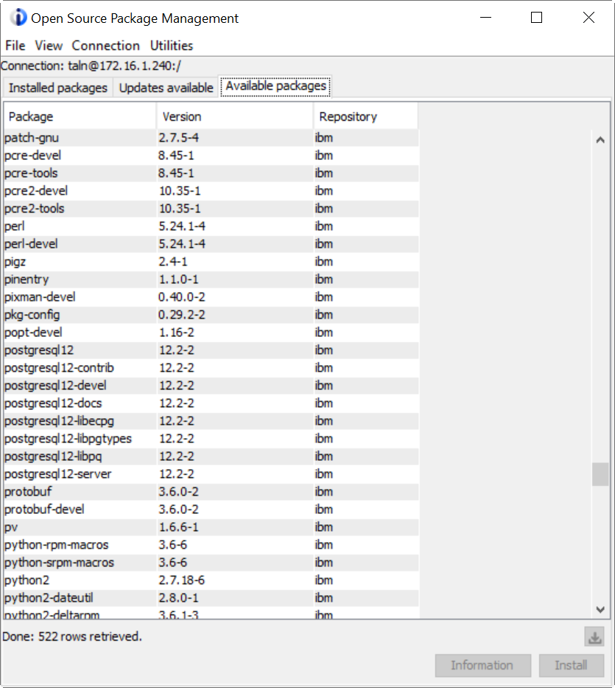
Note : The list of currently installed Open Source packages is displayed.
Available packages from IBM repository
Don’t have PHP packages.
Notes:
http://public.dhe.ibm.com/software/ibmi/products/pase/rpms/repo/ppc64/

Slide 5
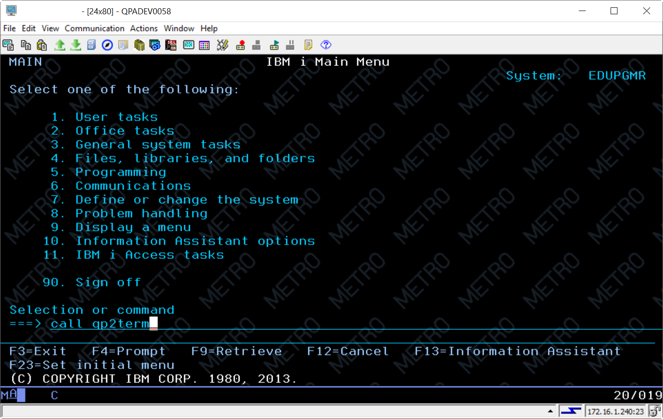
Step 4 : Use this command to run an PASE :
CALL QP2TERM

Slide 6
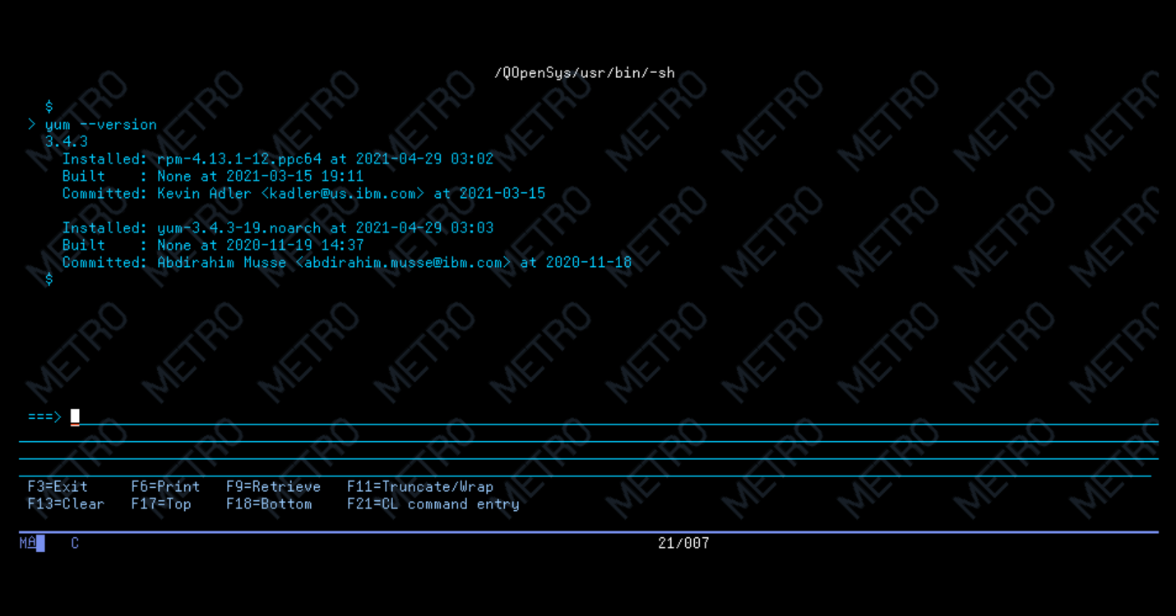
Step 5 : Check yum version
yum --version
Notes:
PATH=/QOpenSys/pkgs/bin:$PATH
export PATH
https://www.seidengroup.com/php-documentation/how-to-set-the-path-to-open-source-packages-on-ibm-i/

Slide 7
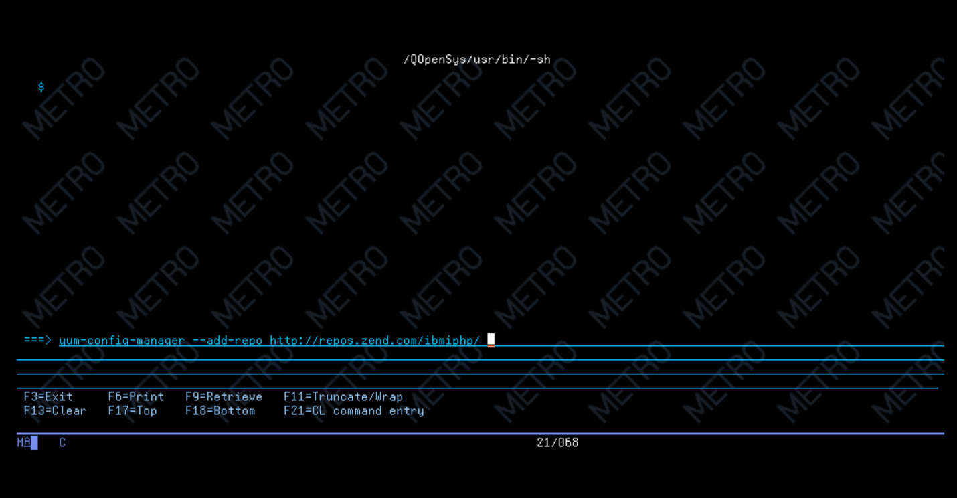
Step 6 : Add repository with command :
yum-config-manager --add-repo http://repos.zend.com/ibmiphp/

Slide 8
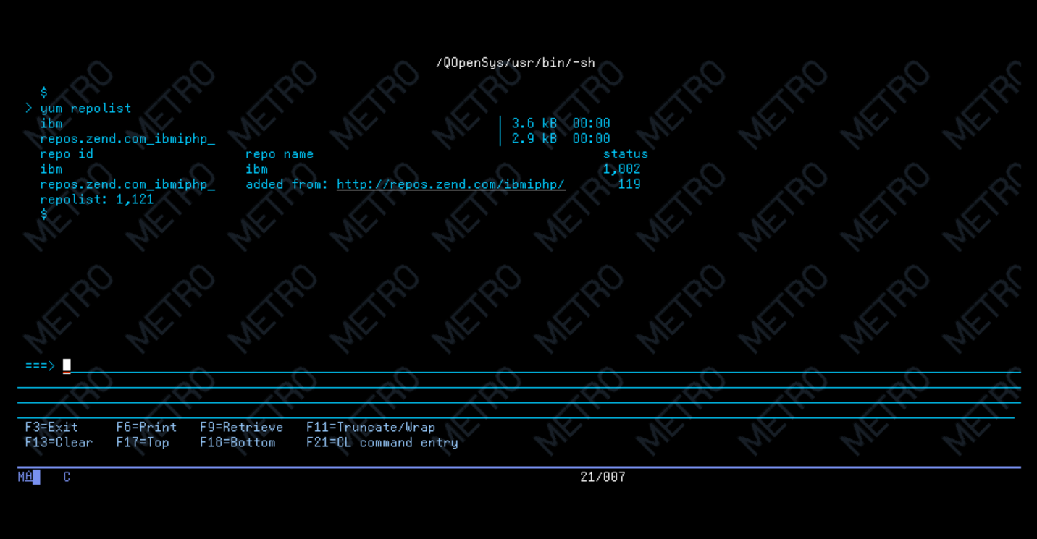
Step 7 : Check Repository before and after added
yum repolist

Slide 9
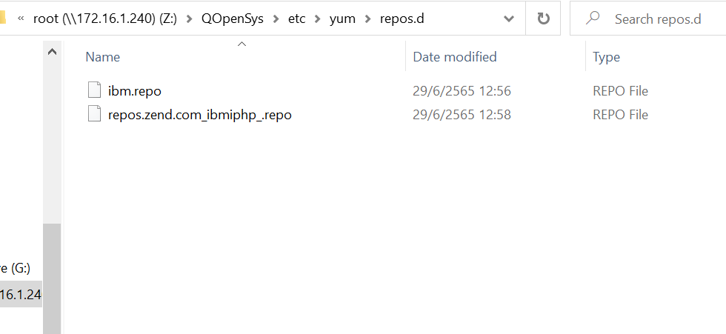
Note : Repository are stored in IFS folder:
/QOpenSys/etc/yum/repos.d/

Slide 10
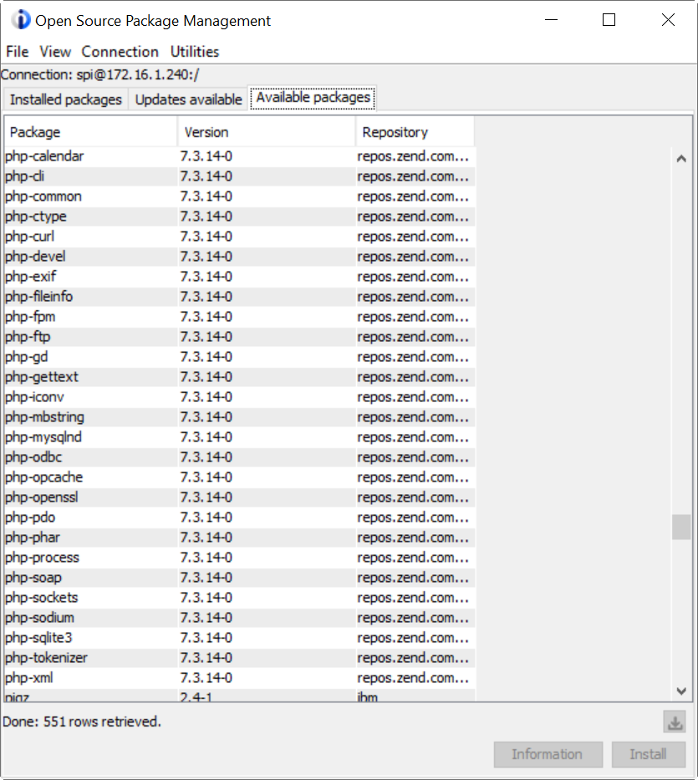
Note :
After added repository in the Available Package will show list of PHP

Slide 11
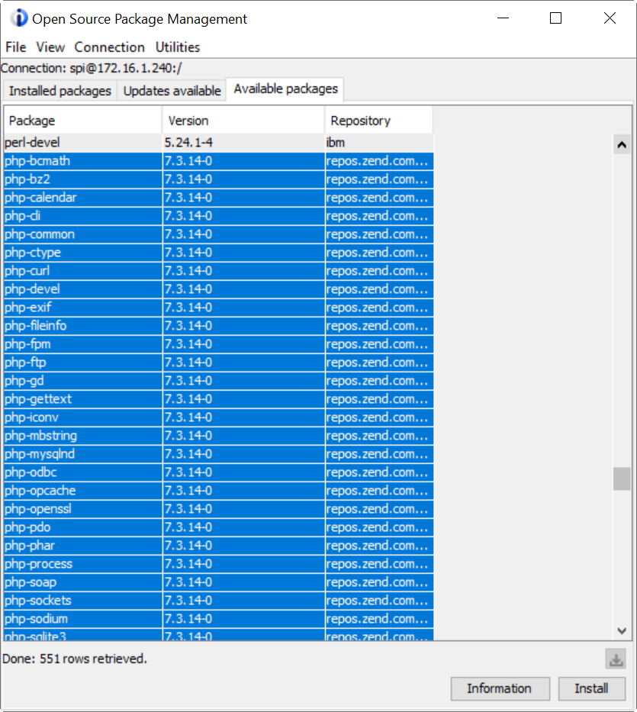
Step 8 : Select all PHP packages
Then click install

Slide 12
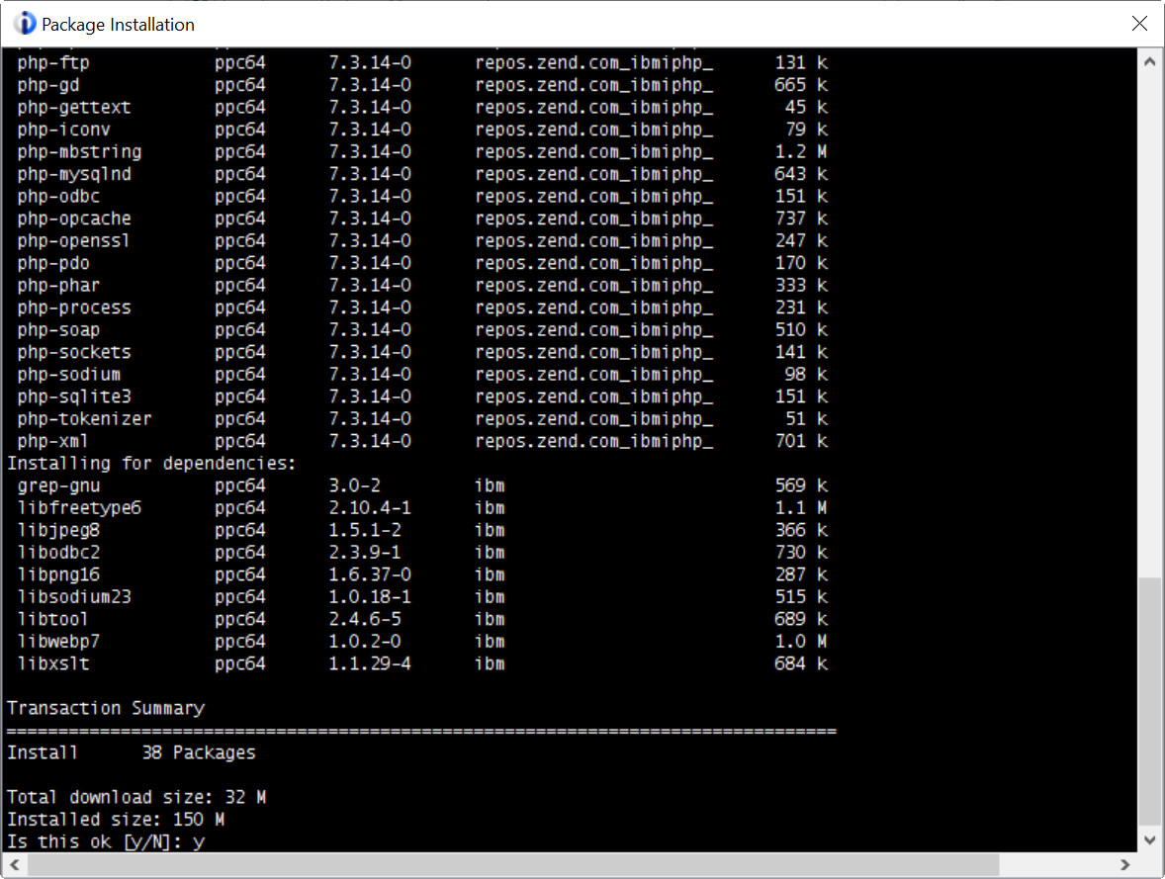
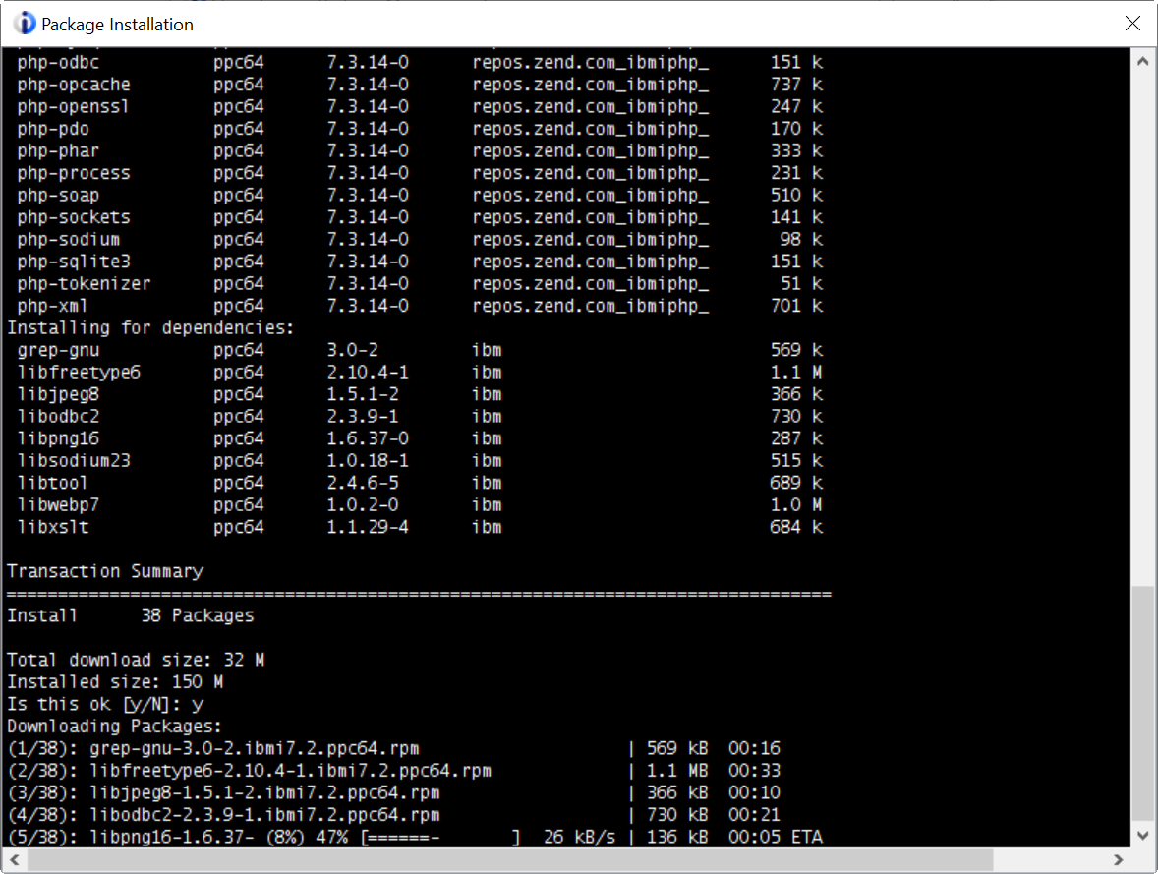
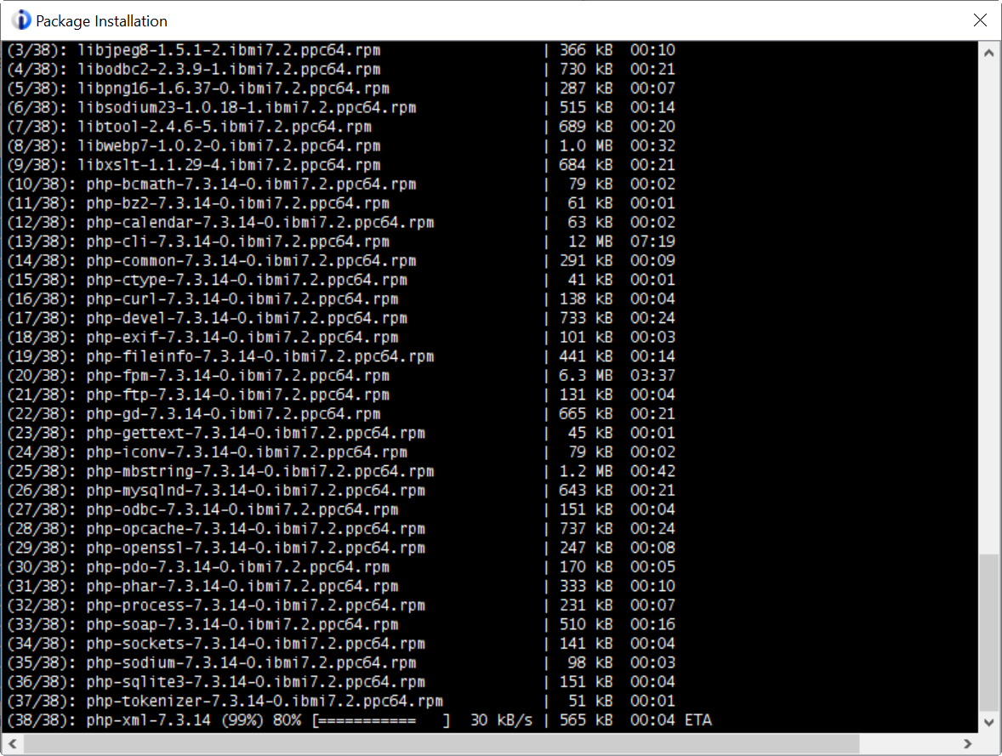
Step 9 : Answer => Y
Wait for downloading all packages

Slide 13
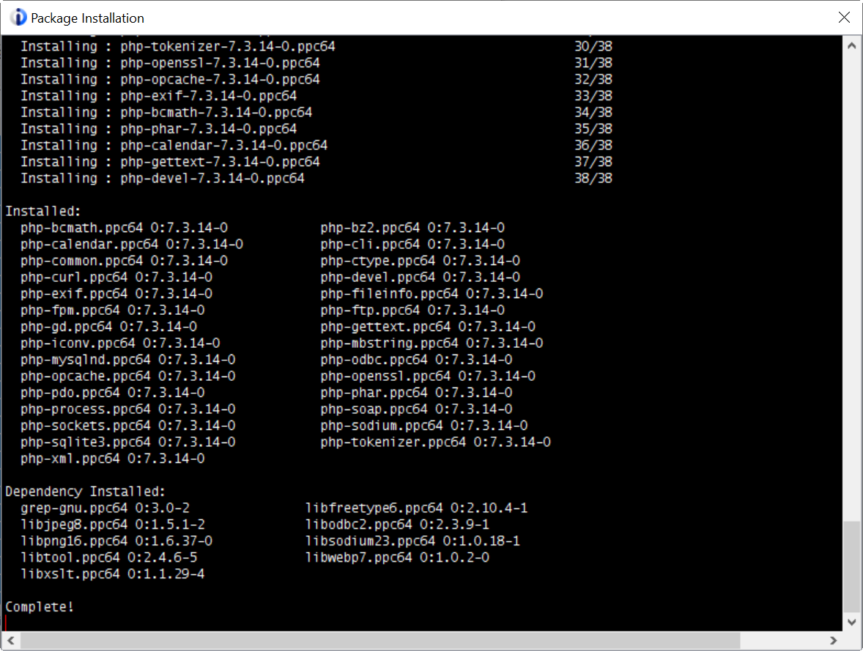
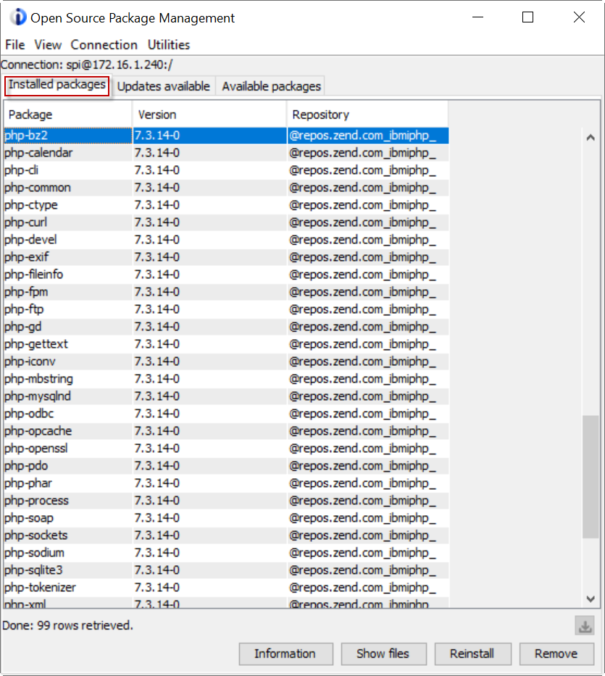
Install Complete!
PHP are in Installed Package Tab >

Slide 14
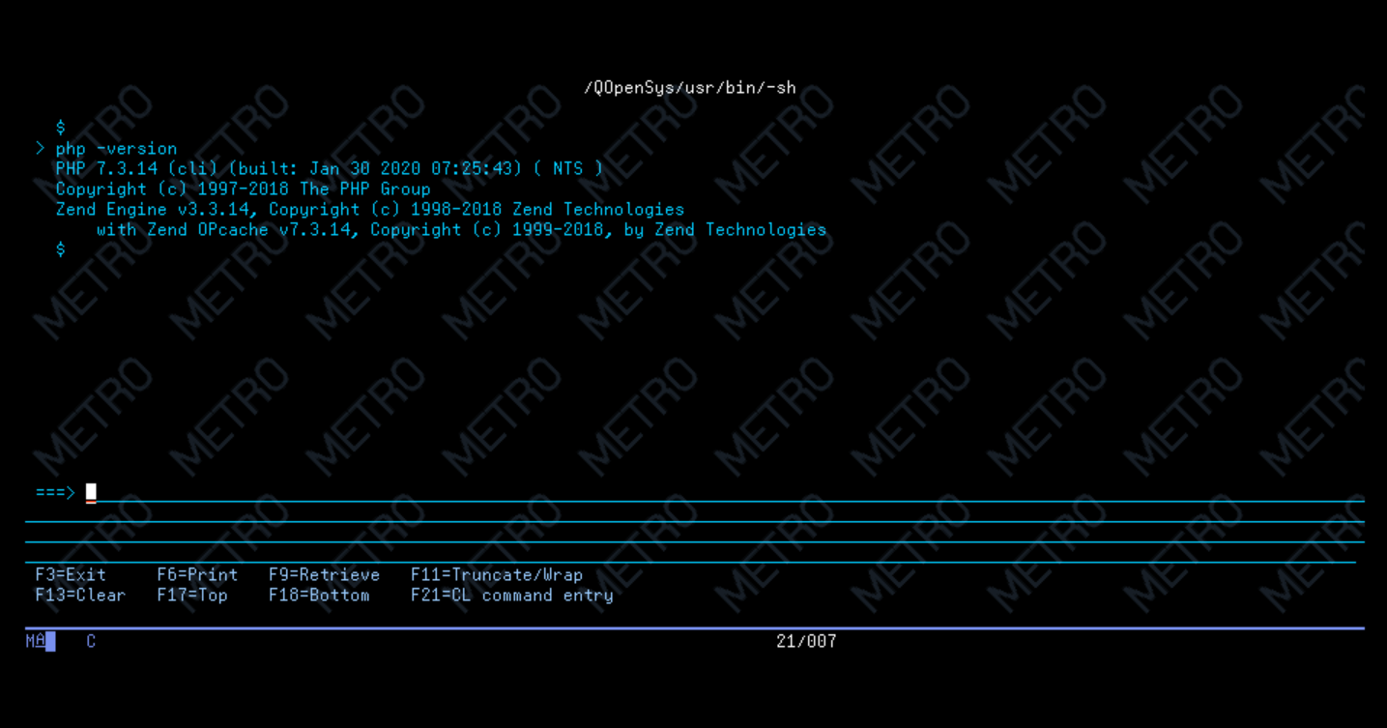
Step 10 : Check PHP version
php -version

Slide 15
Part II: Create Apache Web Server

Slide 16
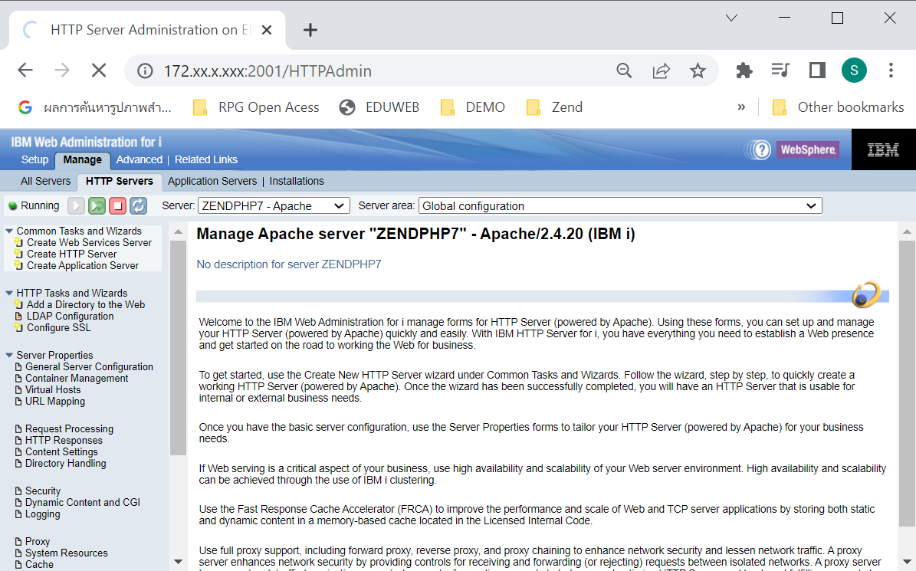
Step 1 : Open IBM I Web Administraion
http://ip-ibmi:2001/HTTPAdmin

Slide 17
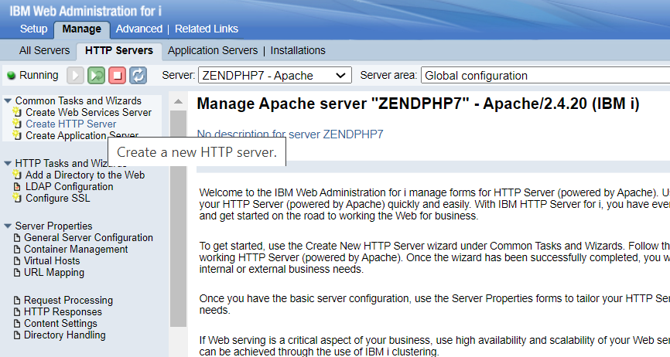
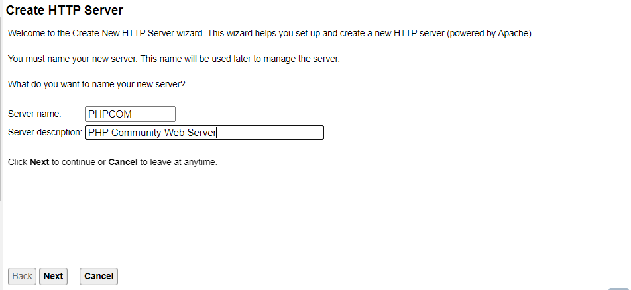
Step 2 : Create HTTP Server
Step 3 :Specify Sever Name:

Slide 18
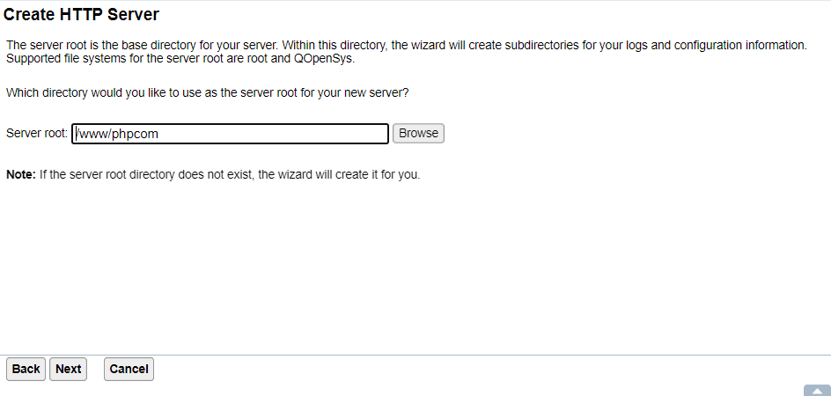
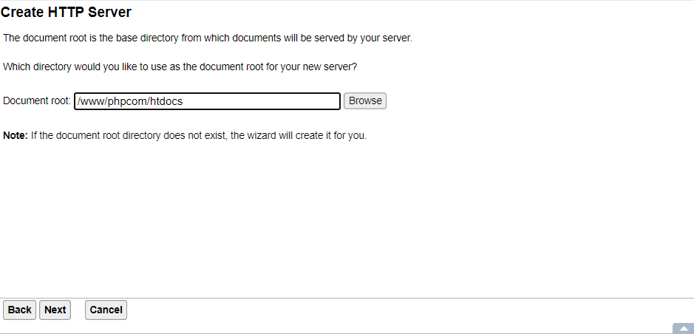
Step 4 : Specify Sever Root : (Use Default)
Step 5 : Specify Document Root : (Use Default)

Slide 19
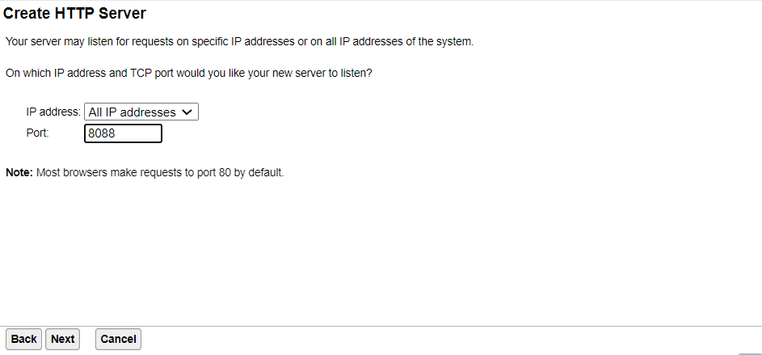
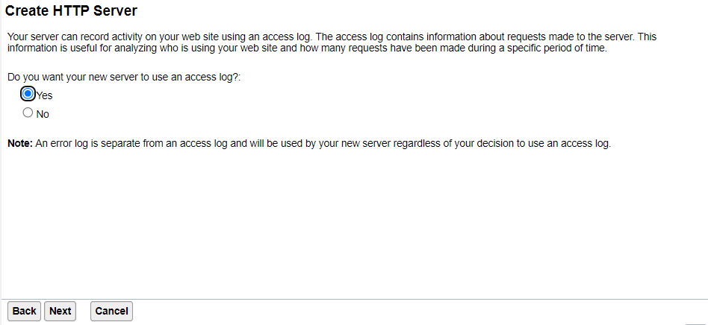
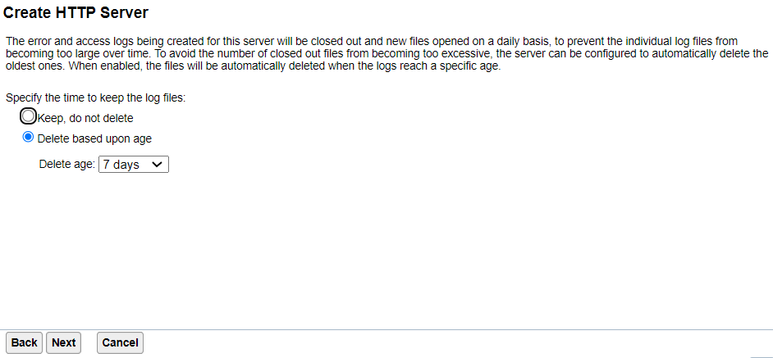
Step 6 : Specify Port :
Step 7 : Click Next
Step 8 : Click Next

Slide 20
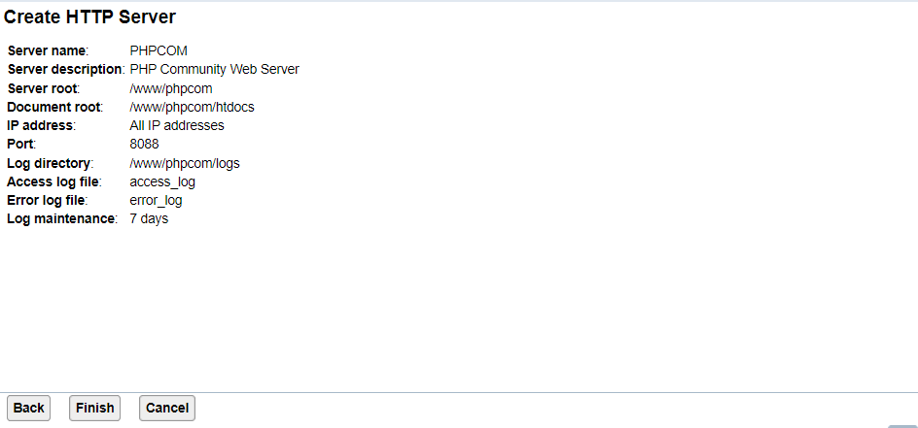
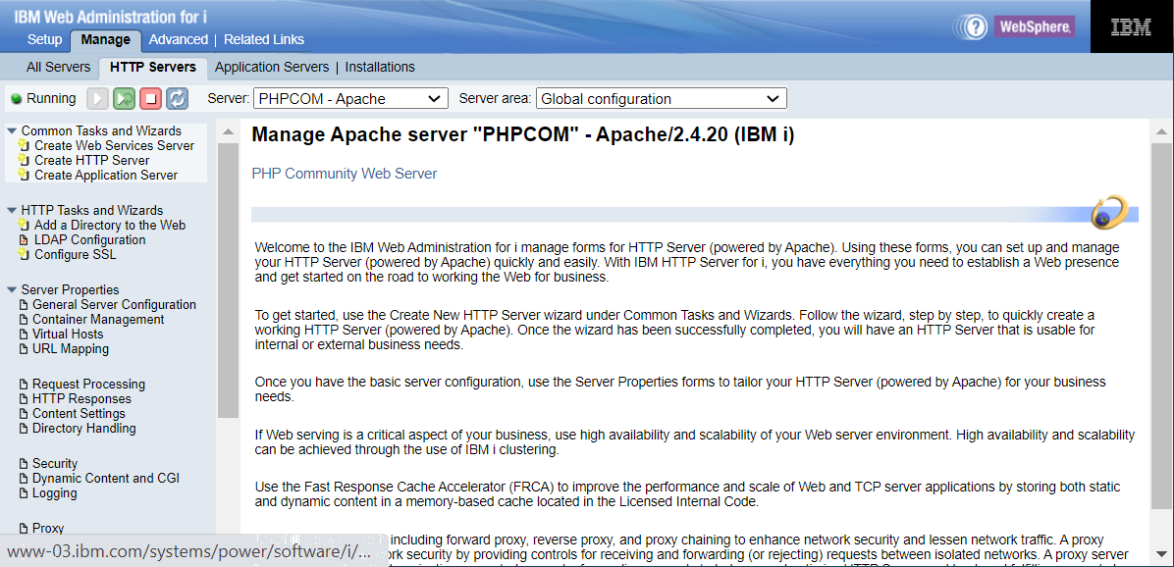
Step 9 : Click Finish
Create Complete! and then click start

Slide 21
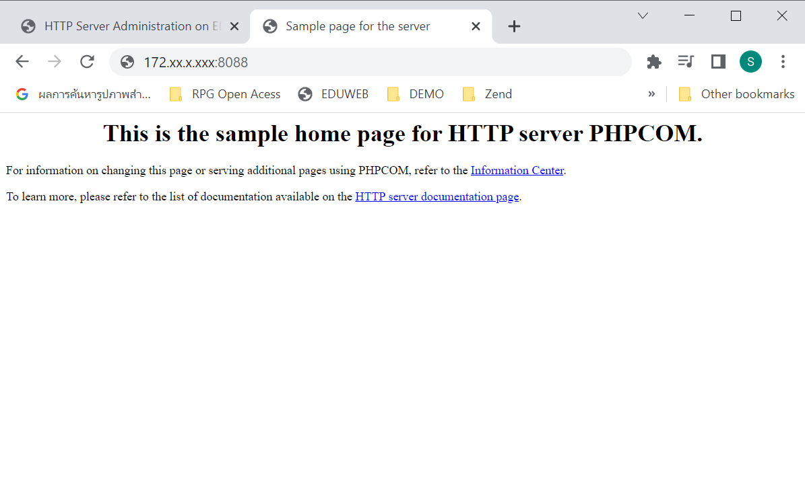
Step 10 : Test Web Server : http://your ip:your port/

Slide 22
Part III: Configure Apache Web Server

Slide 23
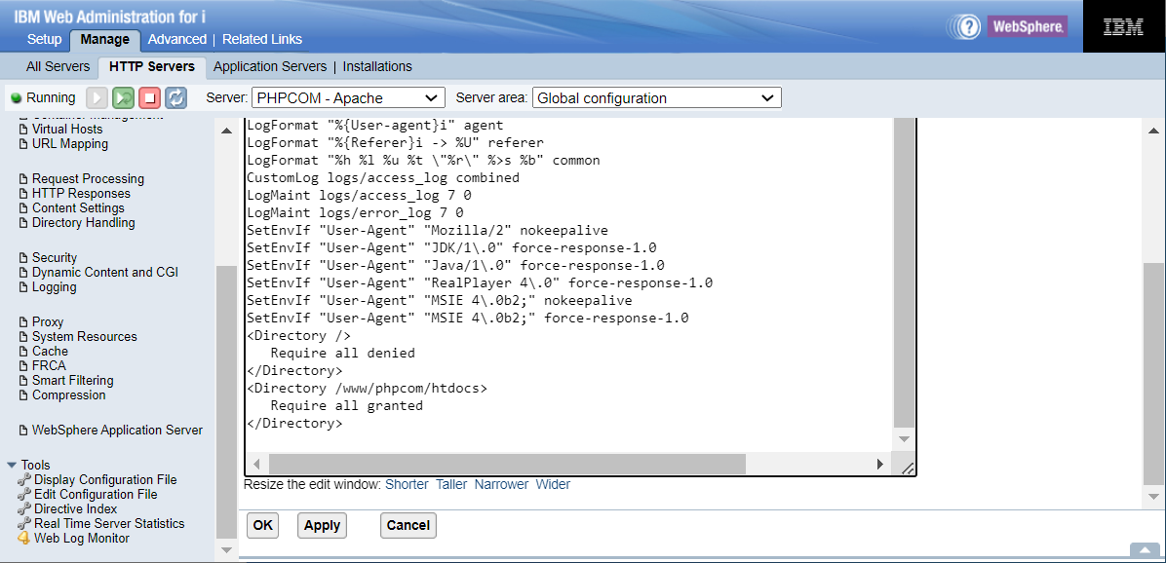
Step 1 : Edit Configuration File

Slide 24
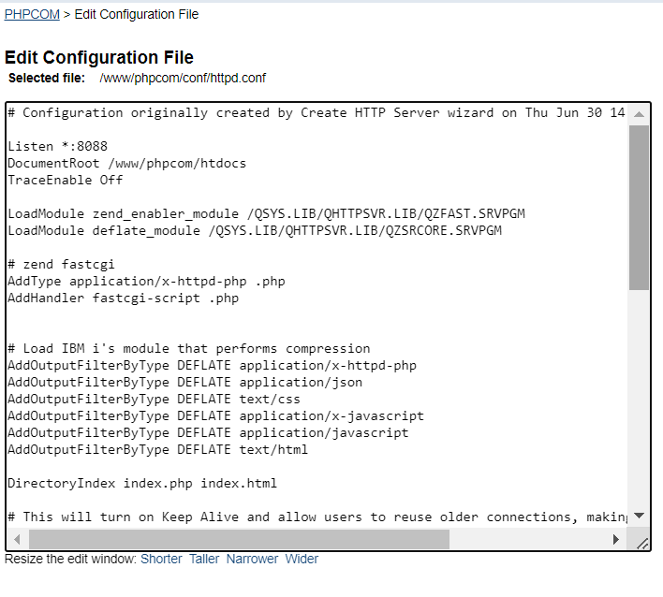
Step 2 : Insert these value into Configuration file
LoadModule zend_enabler_module /QSYS.LIB/QHTTPSVR.LIB/QZFAST.SRVPGM
LoadModule deflate_module /QSYS.LIB/QHTTPSVR.LIB/QZSRCORE.SRVPGM
# zend fastcgi
AddType application/x-httpd-php .php
AddHandler fastcgi-script .php
# Load IBM i's module that performs compression
AddOutputFilterByType DEFLATE application/x-httpd-php
AddOutputFilterByType DEFLATE application/json
AddOutputFilterByType DEFLATE text/css
AddOutputFilterByType DEFLATE application/x-javascript
AddOutputFilterByType DEFLATE application/javascript
AddOutputFilterByType DEFLATE text/html
DirectoryIndex index.php index.html

Slide 25
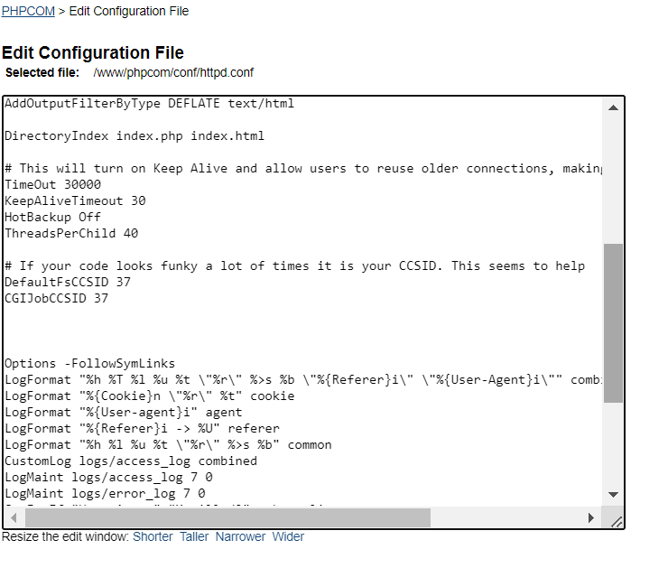
#This will turn on Keep Alive and allow users to reuse older connections,
TimeOut 30000
KeepAliveTimeout 30
HotBackup Off
ThreadsPerChild 40
# If your code looks funky a lot of times it is your CCSID.
DefaultFsCCSID 37
CGIJobCCSID 37
Notes:
https://github.com/K3S/IBM-i-PHP-PDO-ODBC-Toolkit-Setup

Slide 26
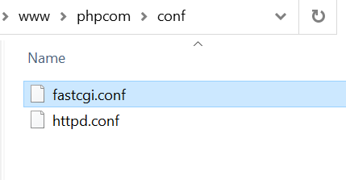
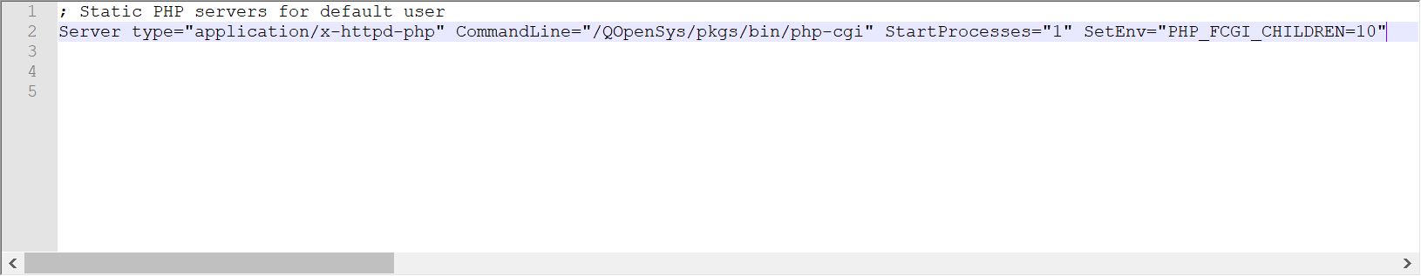
Step 3 : Create file in directory /www/phpcom/conf : fastcgi.conf
Step 4 : Enter this setting in fastcgi.conf
Server type="application/x-httpd-php" CommandLine="/QOpenSys/pkgs/bin/php-cgi" StartProcesses="1" SetEnv="PHP_FCGI_CHILDREN=10"

Slide 27
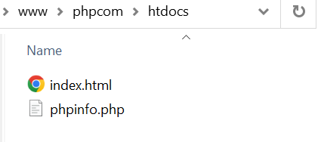
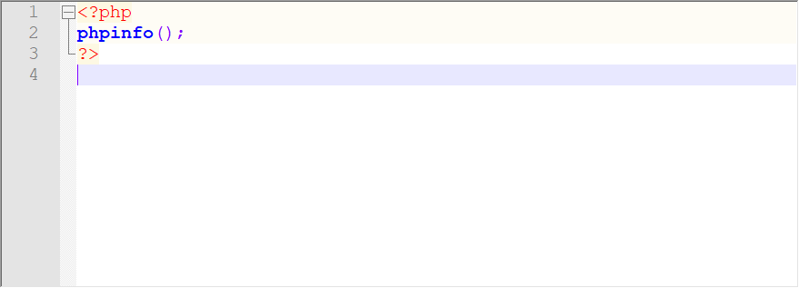
Step 5 : Restart HTTP Server and
Step 6 : Coding PHP Script in /www/phpcom/htdocs

Slide 28
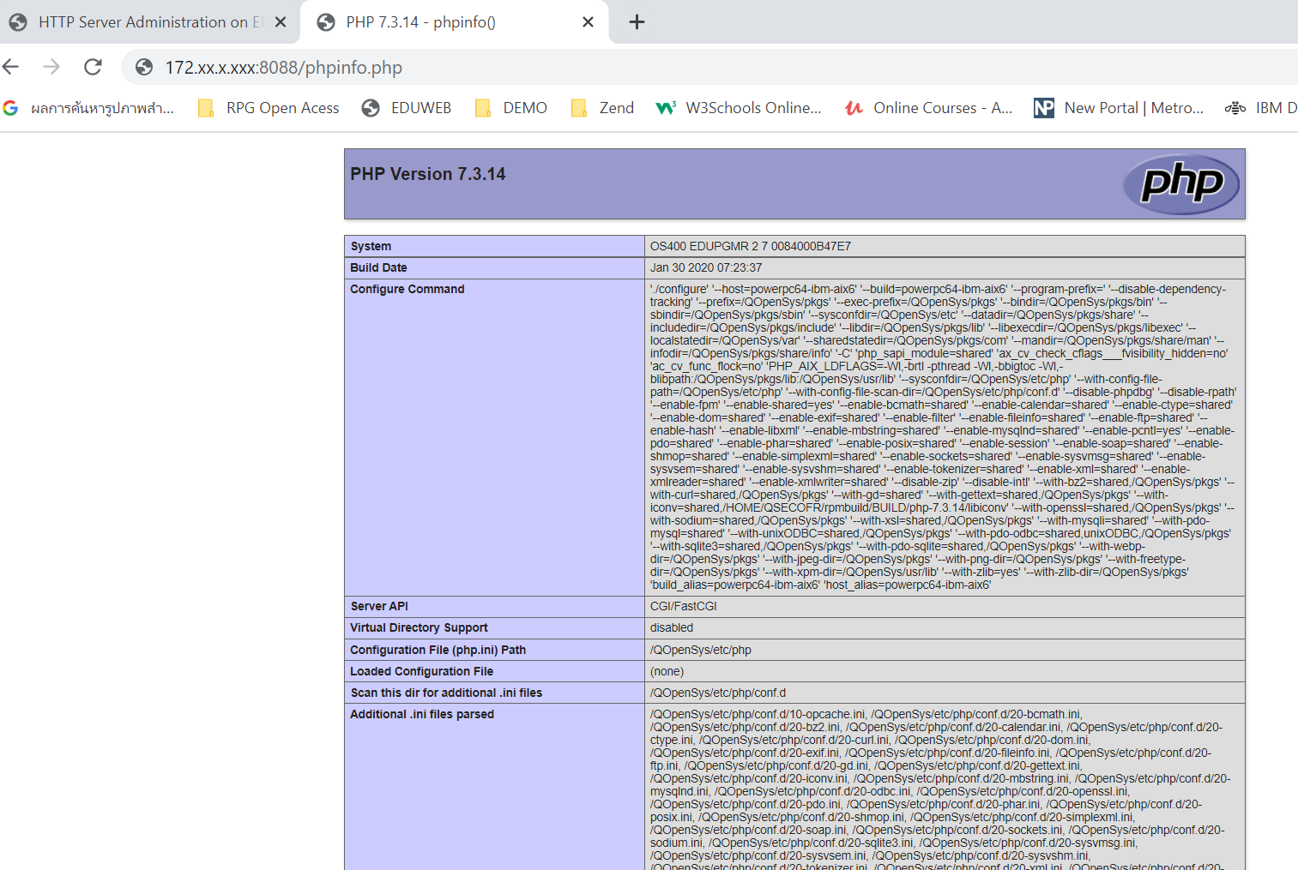
Step 7 : Test run PHP Script
PHP Community running on IBM i

Slide 29
Part IV: ODBC Connection To DB2 On IBM i
Notes:
PDO (PHP Database Object) is an abstracted database connection developed for PHP

Slide 30
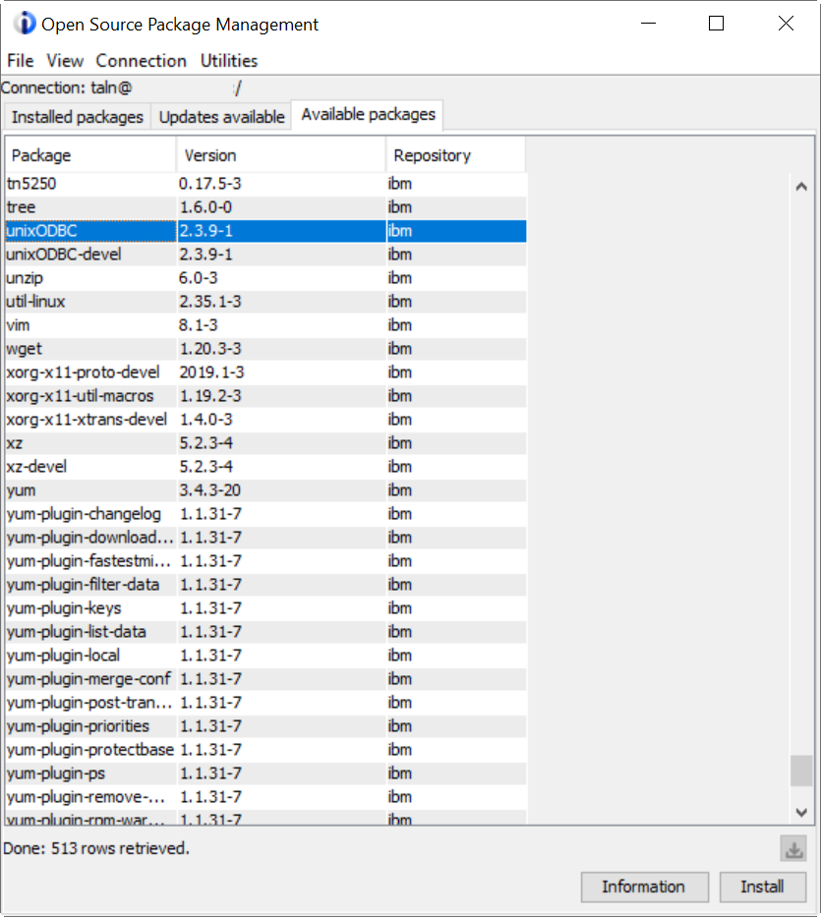
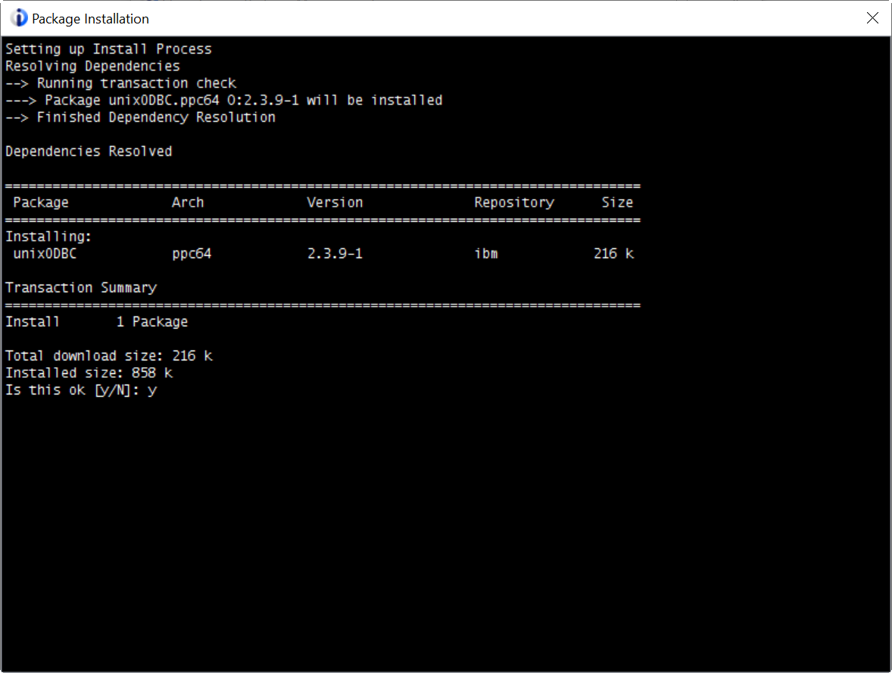
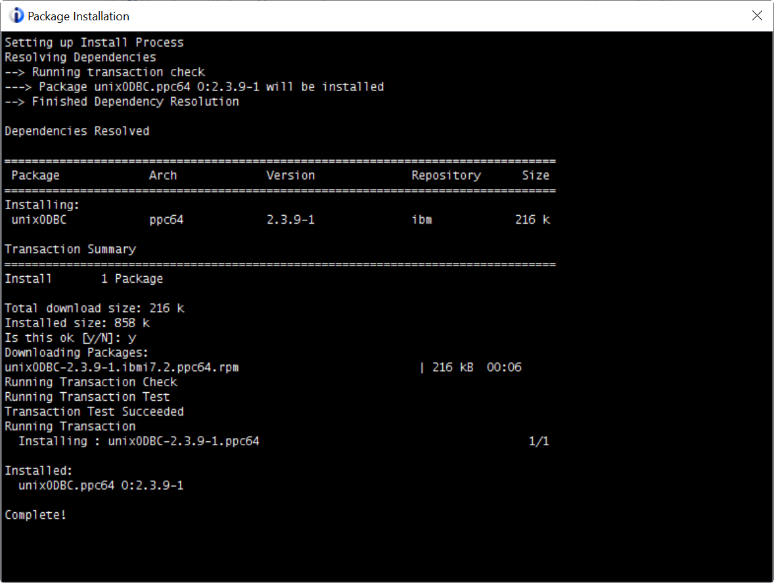
Step 1 : Install UnixODBC

Slide 31
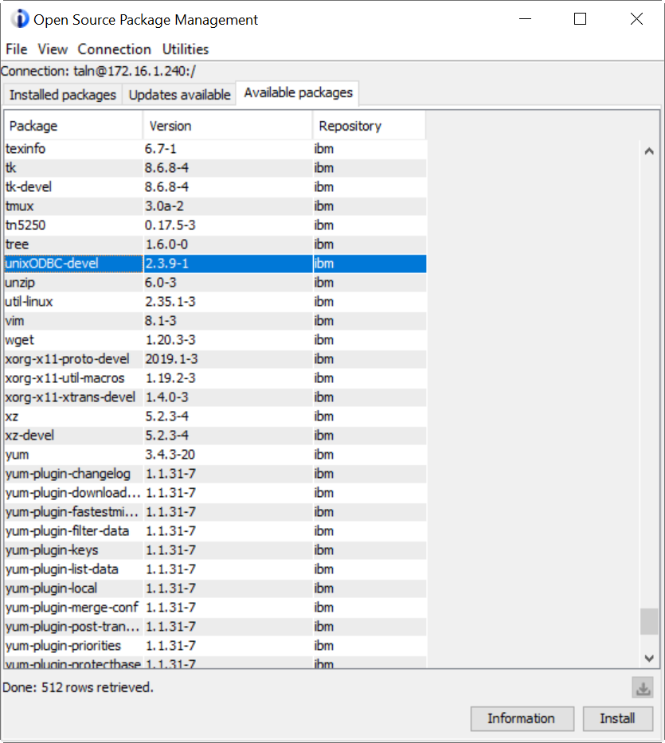

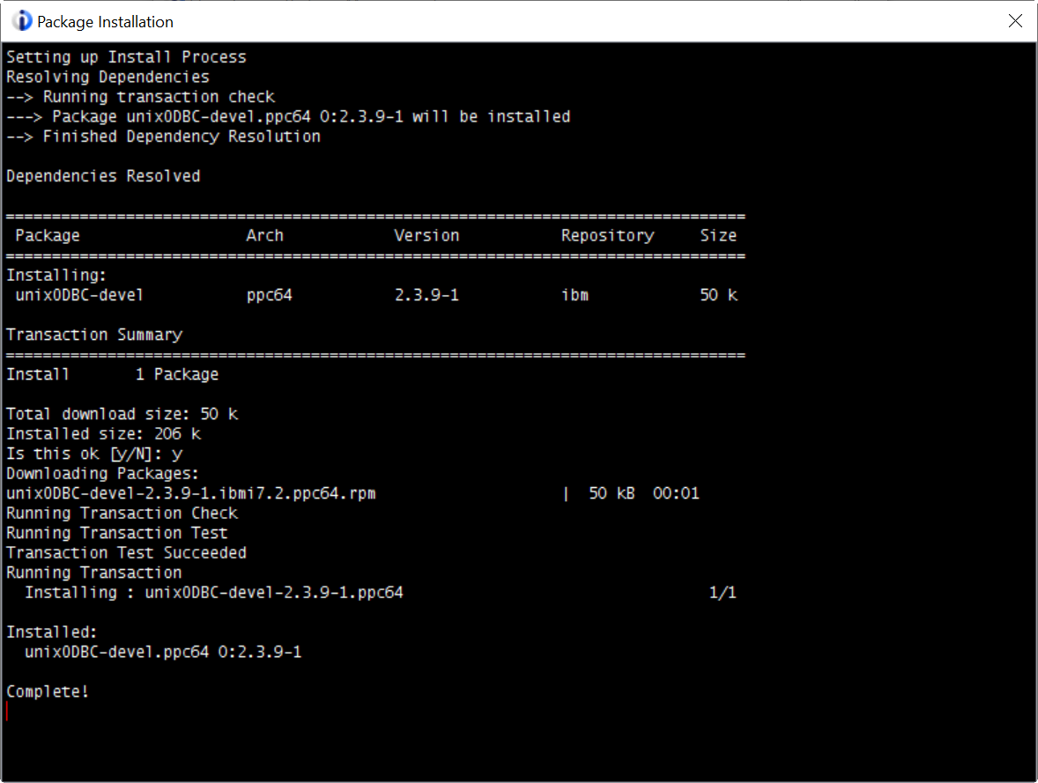
Step 2 : Install UnixODBC-devel

Slide 32
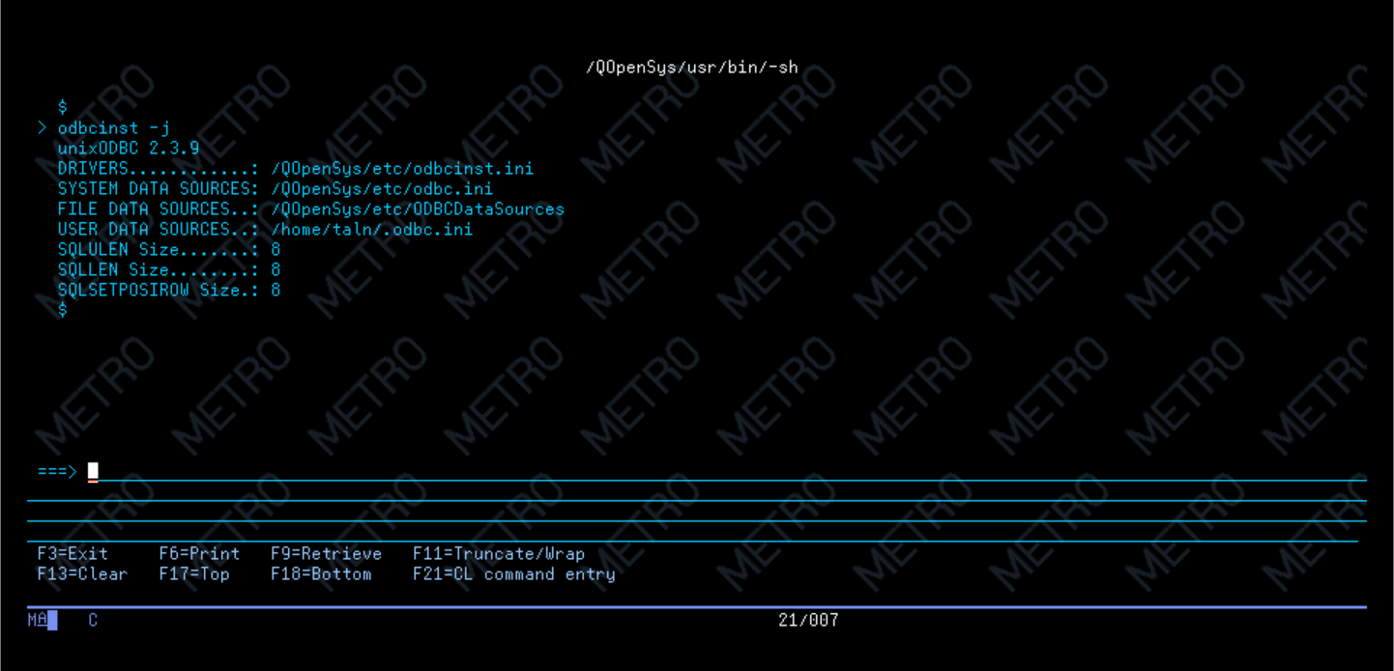
Step 3 : Verify the location of the unixODBC configuration files
odbcinst -j

Slide 33
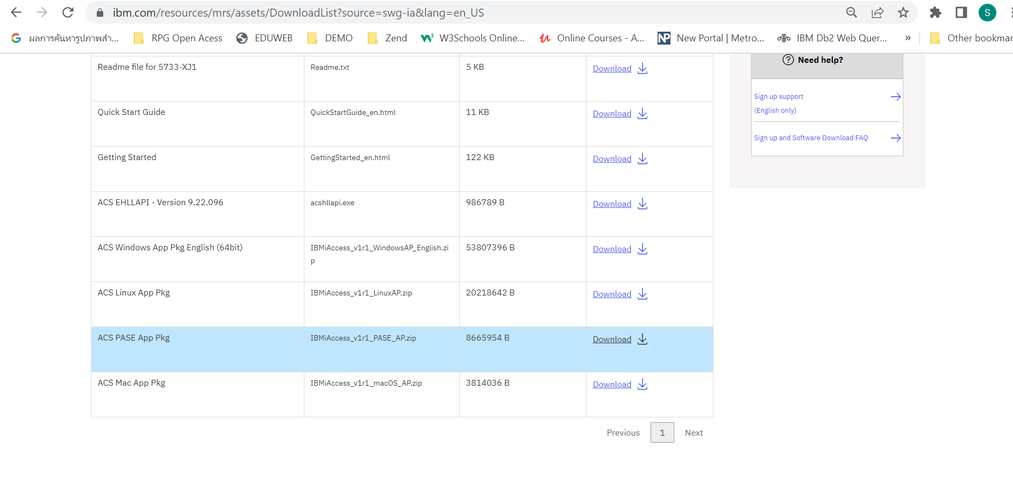
Step 4 : Download ACS PASE App Pkg
https://www.ibm.com/support/pages/ibm-i-access-client-solutions
Notes:
https://www.ibm.com/support/pages/ibm-i-access-client-solutions

Slide 34
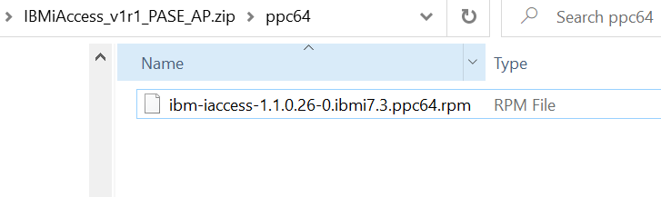
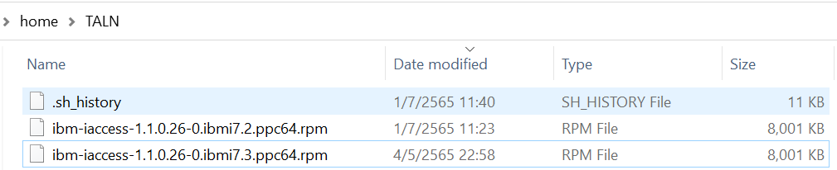
Step 5 : Unzip and Copty to IFS Folder
Path /home/user
Notes:
https://library.roguewave.com/display/SUPPORT/Getting+started+with+the+PDO_ODBC+PHP+extension+on+the+IBM+i

Slide 35
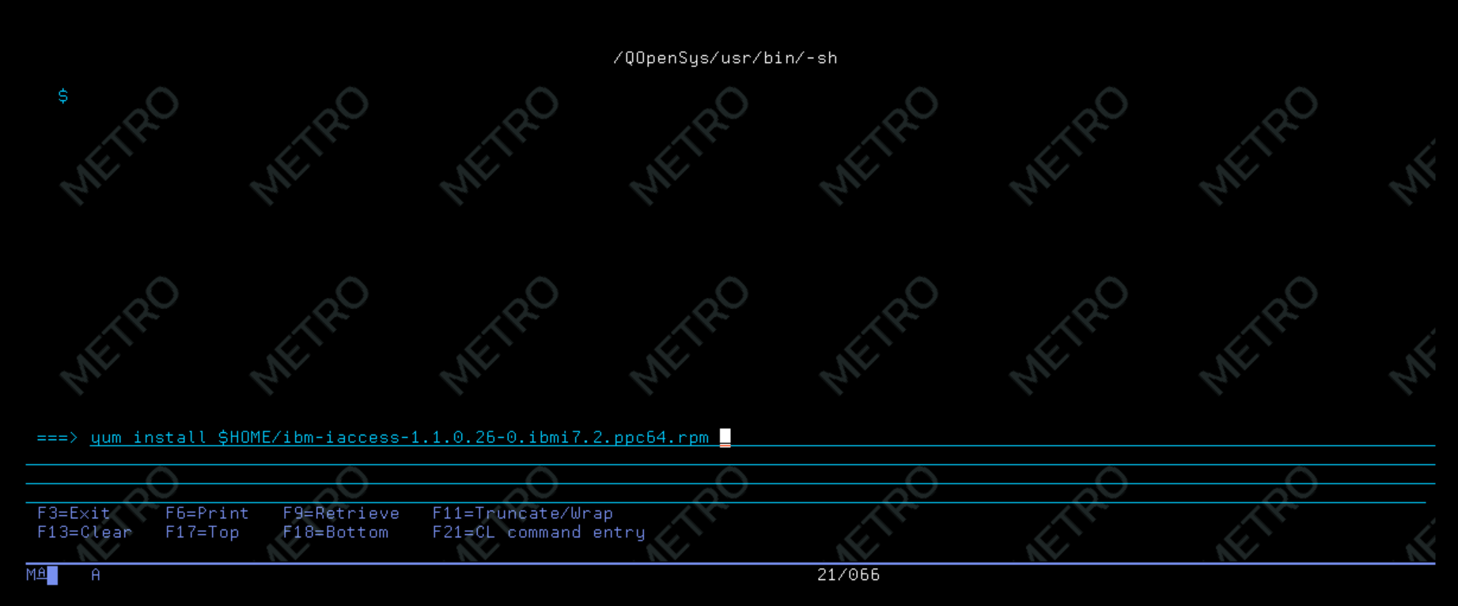
Step 6 : Install ibm-access driver
yum install $HOME/ibm-iaccess-1.1.0.26-0.ibmi7.2.ppc64.rpm

Slide 36
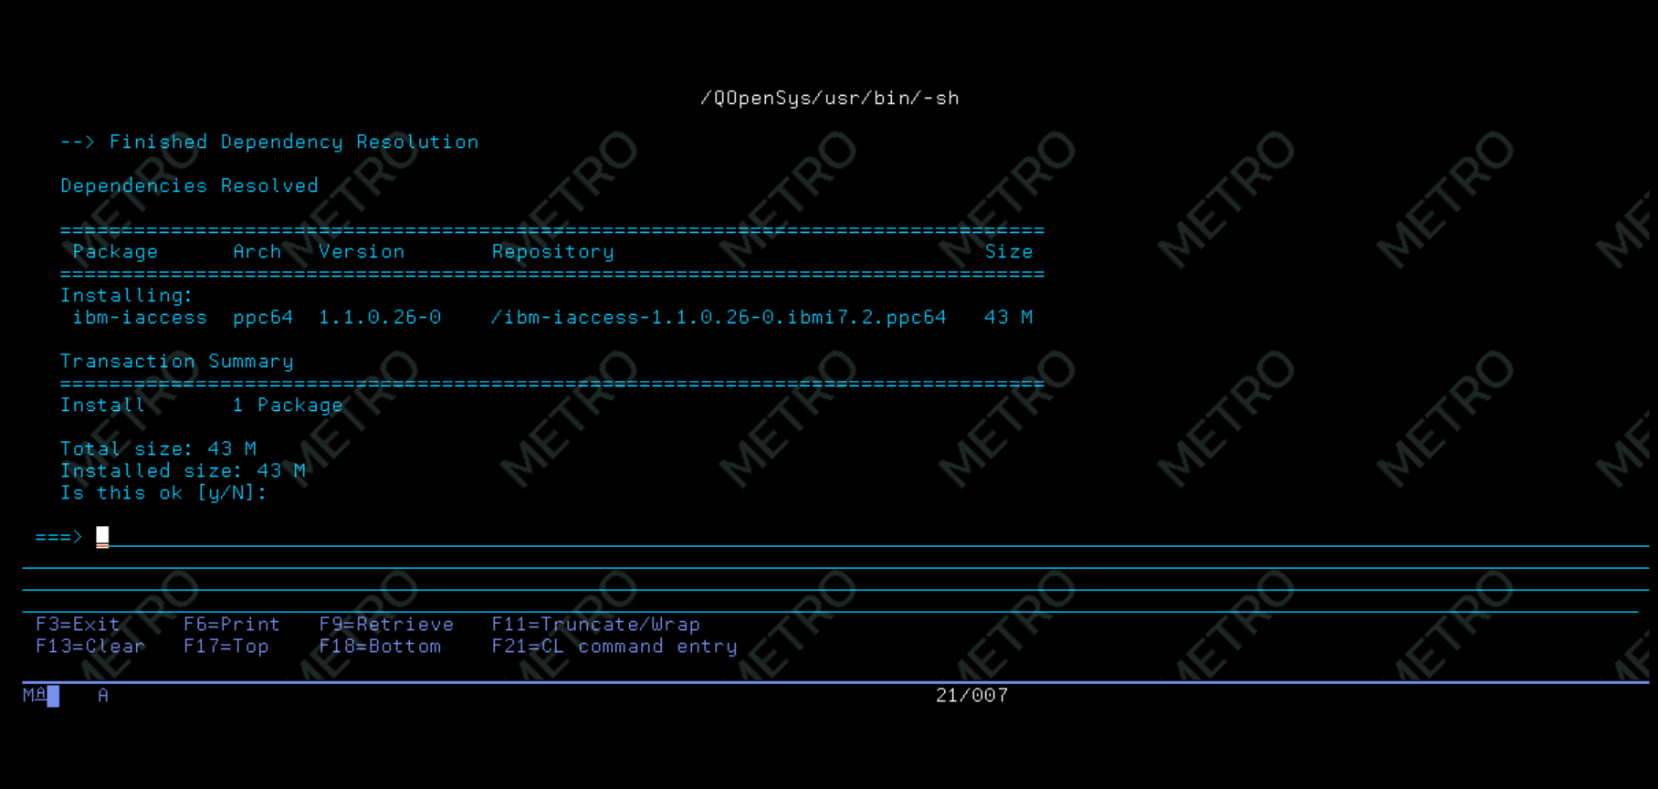
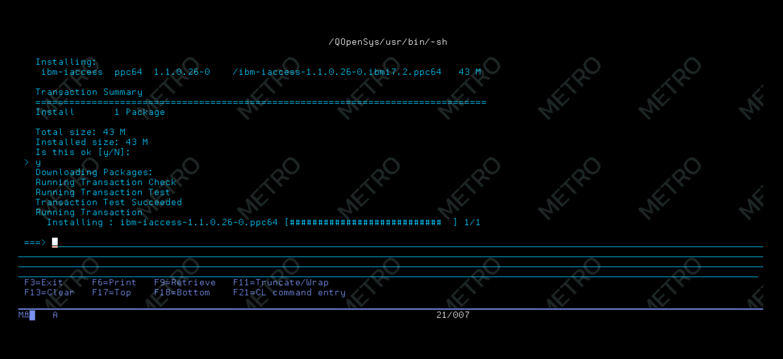
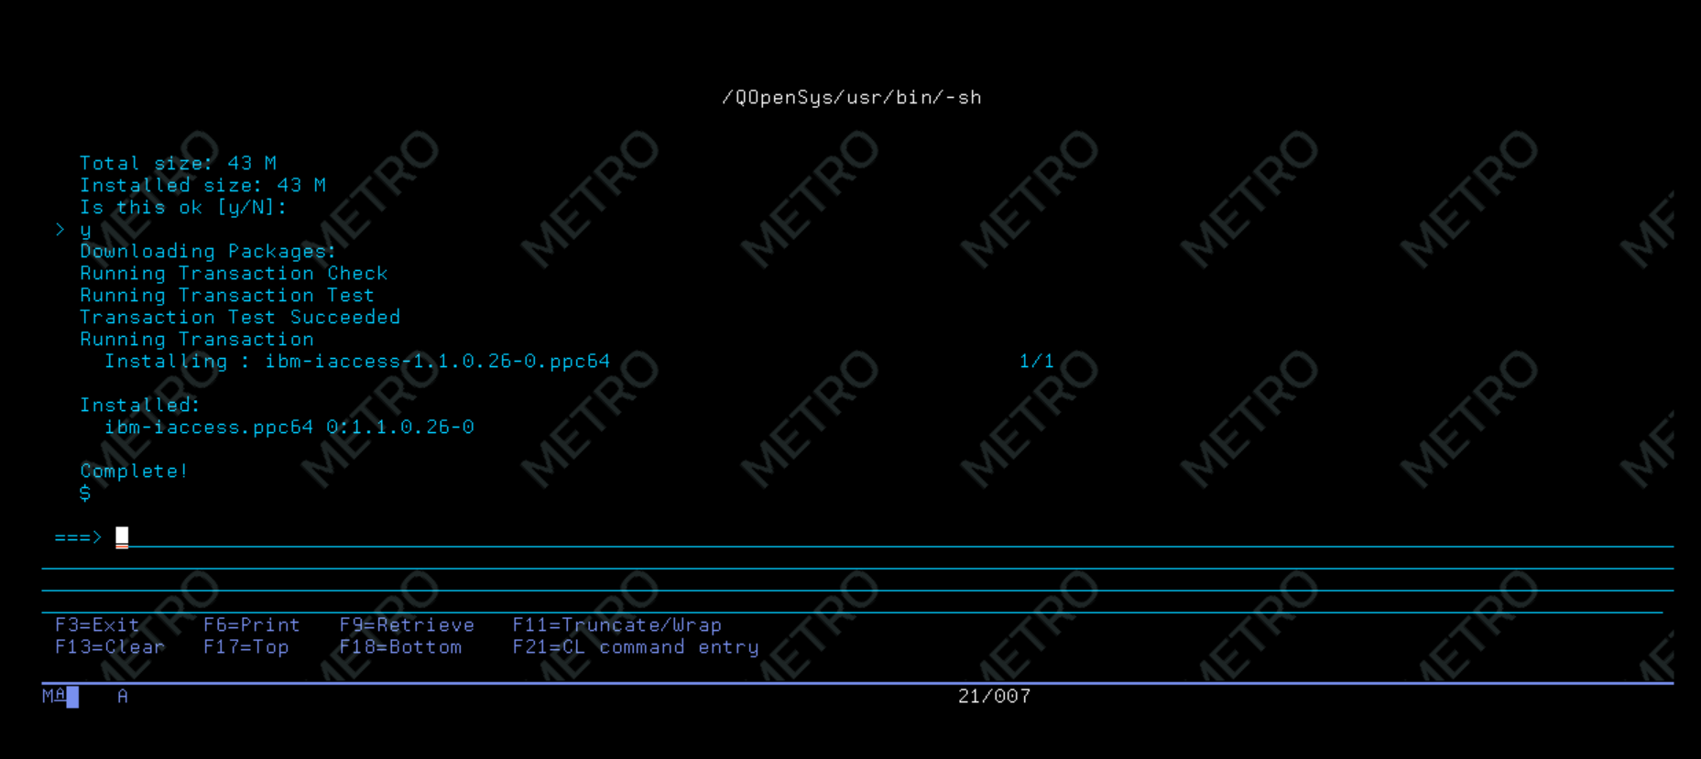

Slide 37



Step 7 : Verify install ibm-iaccess will setting driver info in odbc.ini and odbcinst.ini
/QOpenSys/etc
odbc.ini
odbcinst.ini

Slide 38

Step 8 : Testing script connect to Database
<?php
$conn = odbc_connect("DRIVER={IBM i Access ODBC Driver};System=172.16.1.240", 'DEMO', 'DEMO');
if (!($conn)) {
echo "<p>Connection to DB via ODBC failed: ";
echo odbc_errormsg ($conn );
echo "</p>\n";
}
$a = 'Dallas';
$stmt = odbc_prepare($conn, 'select * from qiws.qcustcdt where CITY = (?)');
$success = odbc_execute($stmt, array($a));
odbc_result_all($stmt);
odbc_free_result($stmt);
odbc_close($conn);
?>
/www/phpcom/htdocs
Notes:
https://www.ibm.com/support/pages/ibm-iaccess-linux-odbc-configuration

Slide 39
Part V: PHP Toolkit for IBM i
Notes:
https://github.com/K3S/IBM-i-PHP-PDO-ODBC-Toolkit-Setup

Slide 40

https://github.com/zendtech/IbmiToolkit
git clone https://github.com/zendtech/IbmiToolkit.git
Notes:
https://www.seidengroup.com/2020/07/23/how-to-access-the-php-toolkit-for-ibm-i/

Slide 41




Slide 42


Slide 43



Slide 44


Slide 45

Notes:
https://github.com/IBM/xmlservice

Slide 46


Slide 47


Slide 48


Slide 49


Slide 50


Slide 51

https://www.seidengroup.com/php-documentation/offline-installation-of-communityplus-php/
OFFLINE

